Slide 1
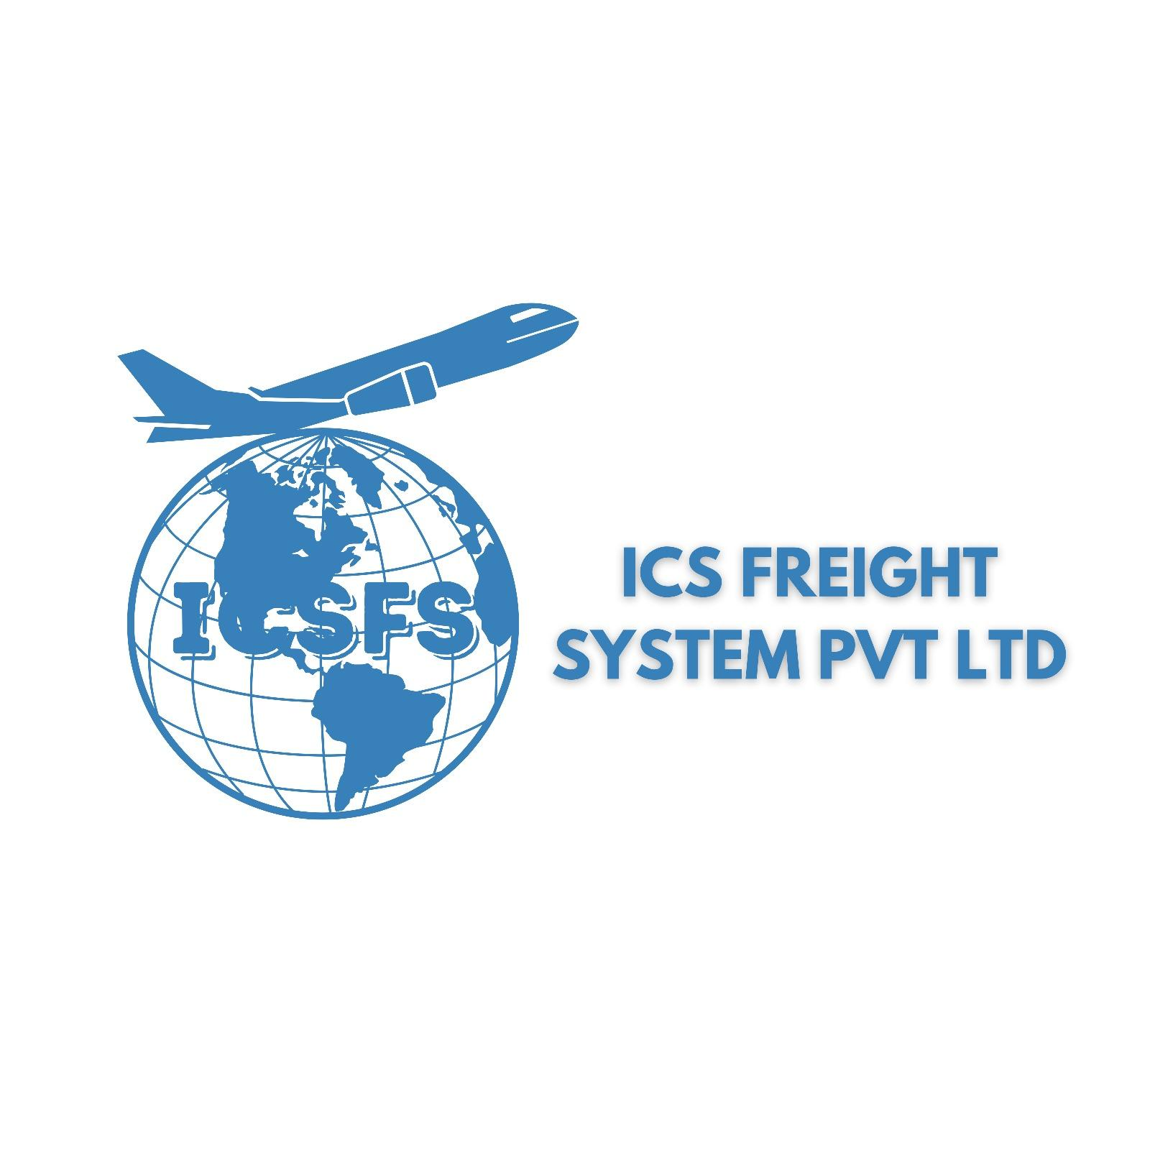
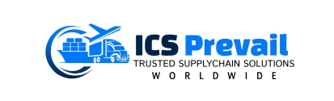

ICS GROUP
AT A GLANCE

Slide 2

ABOUT ICS GROUP
ICS Group has a legacy of 20 years of providing services in logistics, freight forwarding of cargo and customs clearance in both domestic and international markets under the group name in various companies, such as ICS Freight system private limited and ICS prevail logistics Pvt Ltd.
ICS Freight system was established in the year 2005 by entering the Customs brokerage services and customs clearing in India, while with the time we extended our business in multi directions. At one end, we increased our line of business services in freight forwarding, break bulk, perishable goods handling expertise, while at another end we extended our services not only in India but also world-wide into multiple countries.
For giving the right structure to the organization with increasing business lines and opportunities, we started ICS Prevail logistics to cater the freight forwarding and other 3PL services into the business revenue.

Slide 3
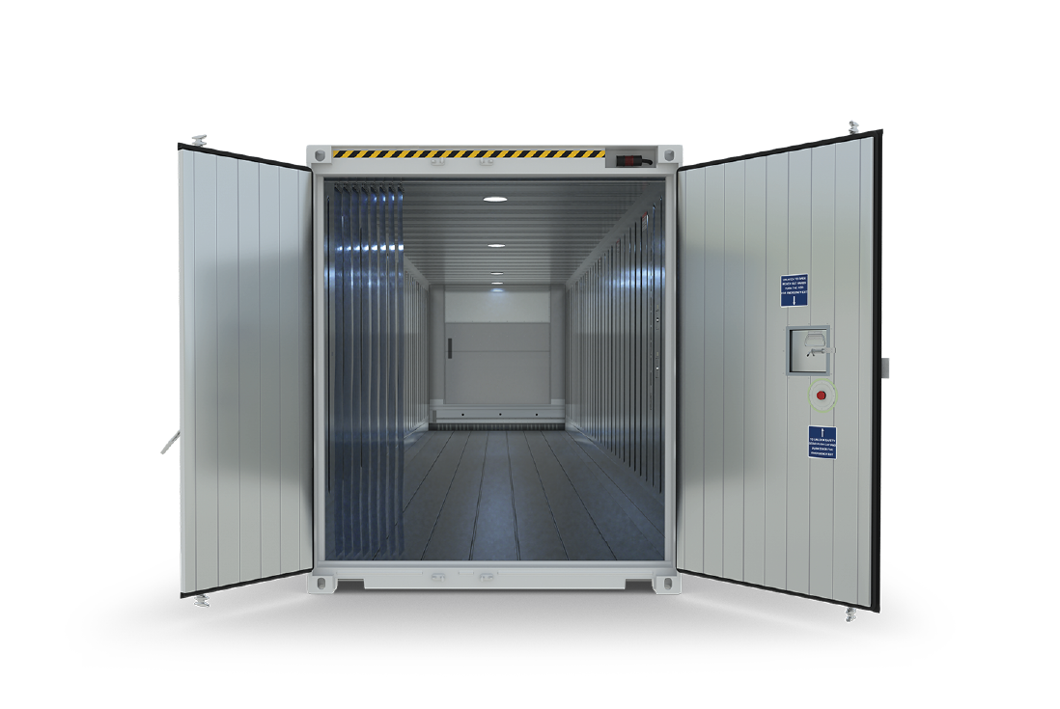
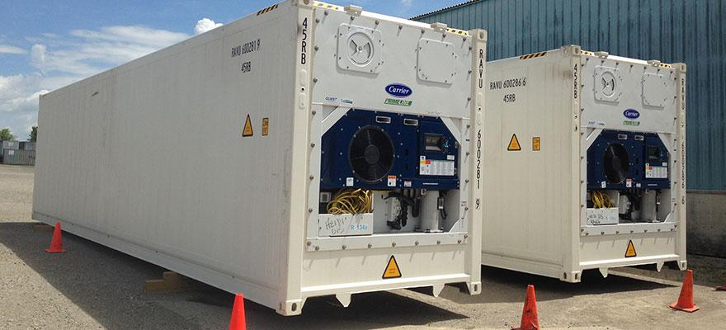
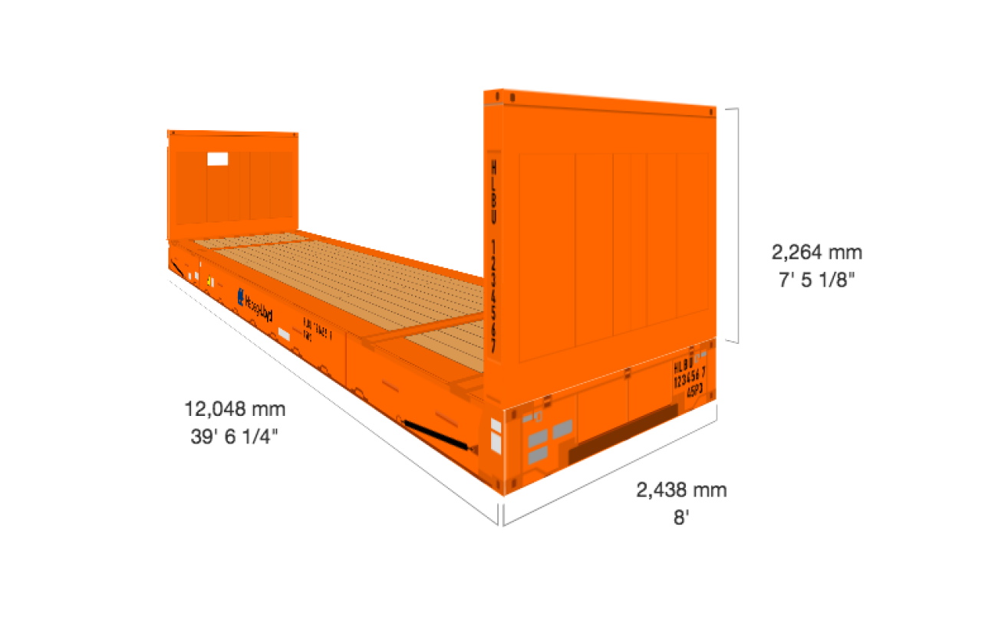
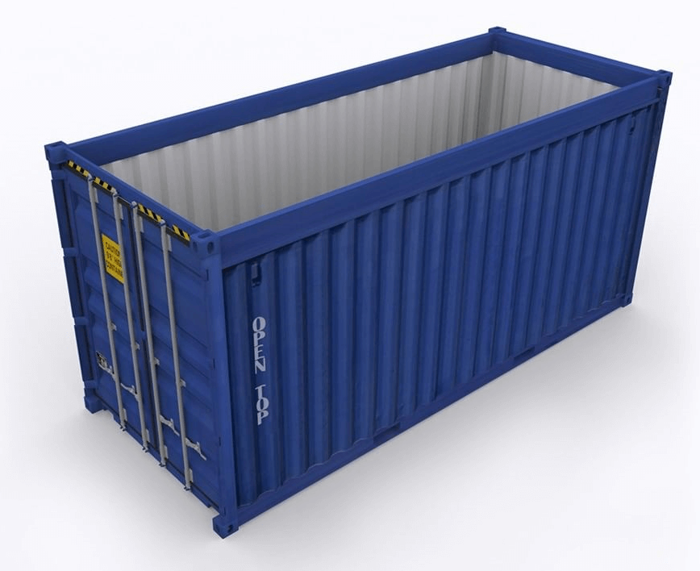
ICS group has capabilities to handle cargo movement of all types of projects, focusing on door to door operations as per customer requirements with the top management supervising every detail and also managing Air freighters from and to different countries and management of SOC containers.
40 Ft. Reefer interior view
40 Ft. Reefer exterior view
40 Ft. Flat Rack
40 Ft. Open Top

Slide 4
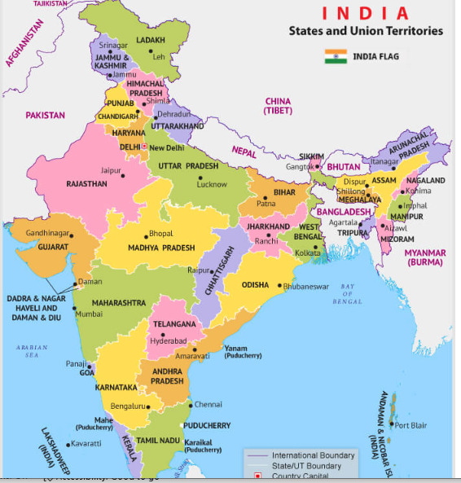
AS CHA, WE ARE REGISTERED IN MULTIPLE CUSTOMS STATIONS IN VARIOUS CITIES.
Delhi NCR– Corporate.
Mumbai – Covers west of India (Maharashtra and Gujarat)
Kolkata – Covers West Bengal / Bangladesh / Nepal and North-East.
Guwahati – Primarily only for North-East
Bangalore – Primarily Karnataka and Air Cargo.
Chennai – South-East India.
Tuticorin – Alternate port for Chennai, catering to Tirupur / Madurai and Salem trade.
Kandla – Primarily Breakbulk movement.
Pipavav – Far east movement of containerized cargo.
Mundra – West movement of Containerized cargo.

Slide 5
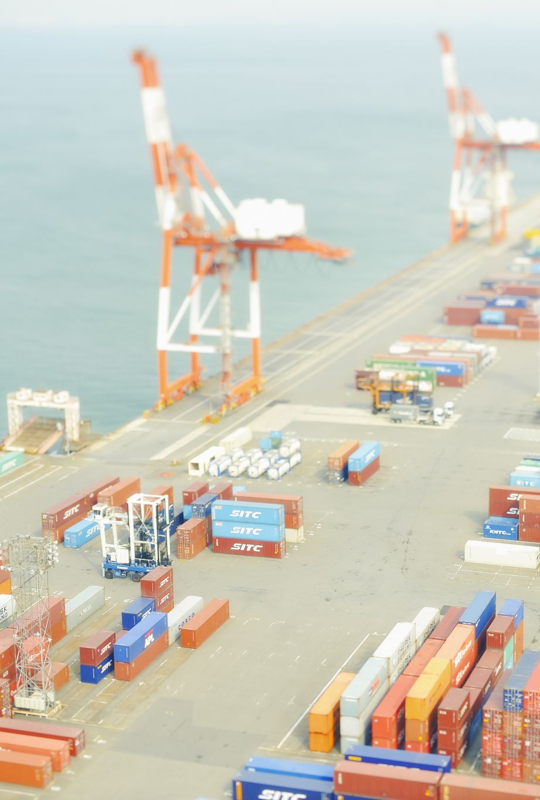
PROJECTS & FOOTPRINTS
ICS group keeps capabilities to handle large project movements, either door to door operations management by keeping high focus with top management supervision and eye on each activity or managing Air charters and SOC containers.
-Few exemplary service footprints:
Moving regular CNG plants to NNPC (Nigerian National Petroleum company), Nigeria via Sea freight and Air charters with 4 years of lock-in service contract.
ICS handled complete plants movement (Door to door) of Milk, Sugar, coffee and salt from Indonesia, Canada, Egypt and Bangladesh to ex SSP, Faridabad.
We moved complete, Chemical Plant from ex Vadodara and Ahmedabad to Doha, Qatar with excellence of our supply chain operations.
Conglomerate, HUL (Hindustan Unilever Limited) appointed us to setup it’s Haridwar plant’s machineries from FR ex Germany and Italy.

Slide 6
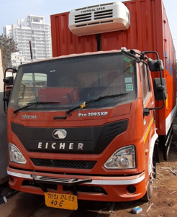
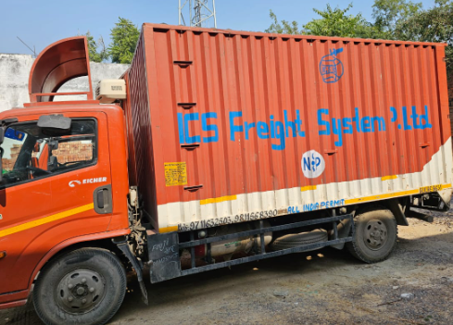
REEFER CARGO & COLD CHAIN SPECIALIZATION
Our specialty is in offering door to door DDP and Reefer container movement. ICS freight group handles the maximum volume of clearance of perishable goods such as fresh fruits, vegetables, frozen processed foods and pharma product imported into the country. We handle the entire chain & clearances of these products including forwarding, customs clearance and delivery from port to warehouse/premises of customer/importer maintaining the entire cold chain .
We have our own fleet of refrigerated trucks to complete the last leg in temperature-controlled environment.
We offer SOC (shipper owned container) inventory as well, to be used as storage unit at the site of construction, just in case the installation of temperature-controlled area is delayed or cooling malfunctions.
Literally maximum volume of perishables (Fresh fruits and vegetables and frozen process foods and pharma) of reefer that is being imported into India is handled by us for forwarding, custom clearance and the delivery to the warehouse (Cold Chain).

Slide 7




BUYER’S CONSOLIDATION
Multi-vendor one buyer consolidation by air sea is another activity that we are doing at ICD ‘s and airport as is the requirement of the overseas consignee.
Some eminent customers, Kmart (USA), GAP (USA), FCUK (UK), Piaggio (Italy), Next Plc (UK).
We offer services even of consolidation of GOH (Garment of hangers)
One of the services only being offered by us in India is an inspection center, exclusively for the buyer.

Slide 8
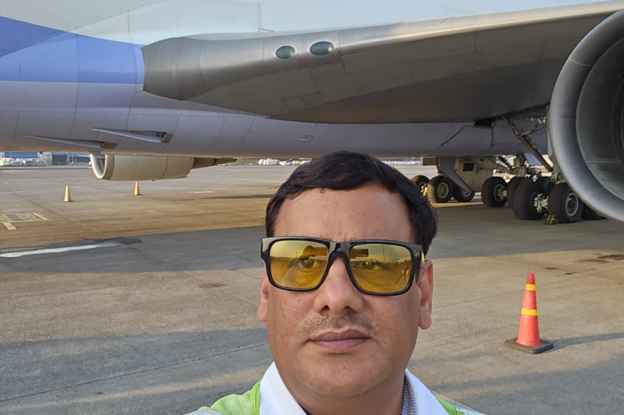
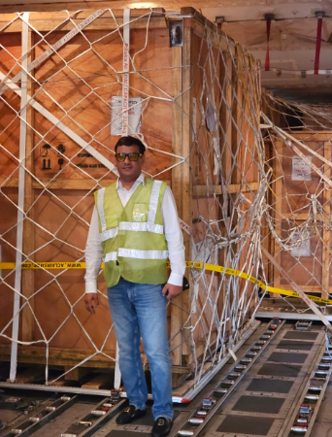
AIR CHARTERING IS ALSO OUR EXPERTISE

Slide 9
COMPANY’S REGISTRATION & CERTIFICATIONS
1
2
3
4
We are registered CHA (Customs House Agents) , registered with Indian customs , License no…….. (attach copy of license
Registered MTO (multimode transporter operator ) , having our own 3.registered MTD (multimode transport document) and HBL (house bill of lading).
We are “BS EN ISO 9001: 2015” registered as well. ISO CERTIFIDE COMPANY
We have very strong worldwide network, by being members of two of the biggest conglomerate of freight forwarding companies (WCA and JC Trans).

Slide 10
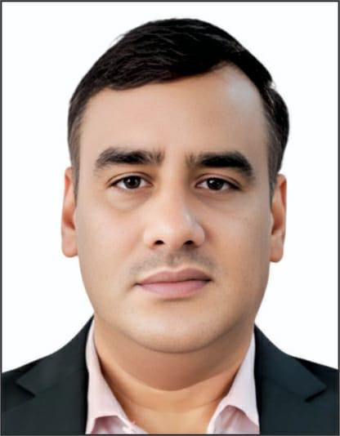
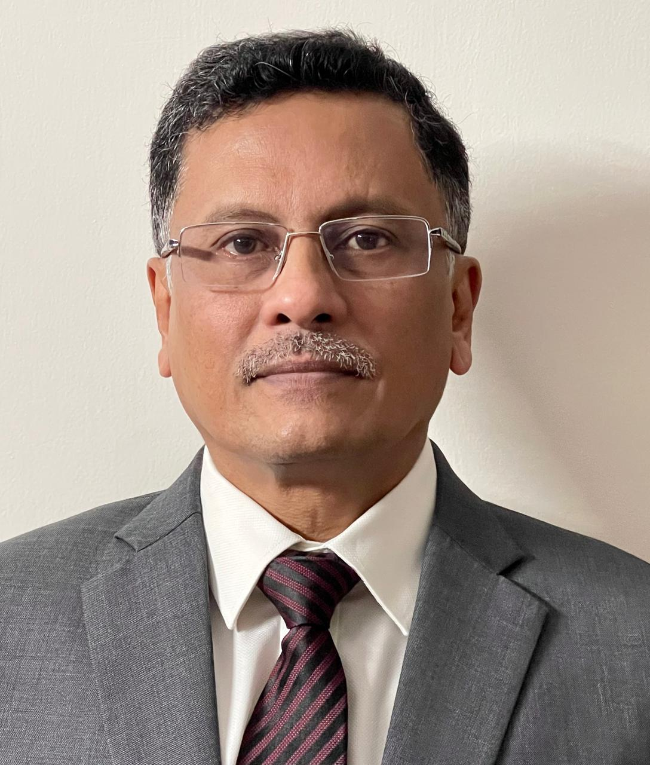
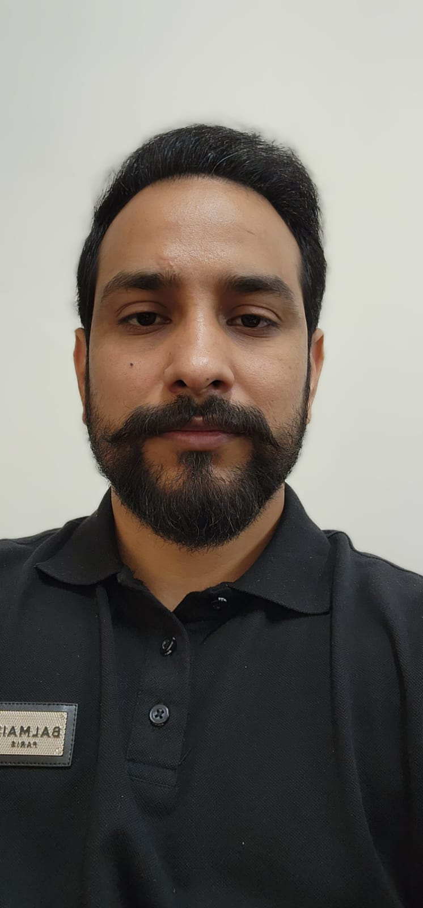
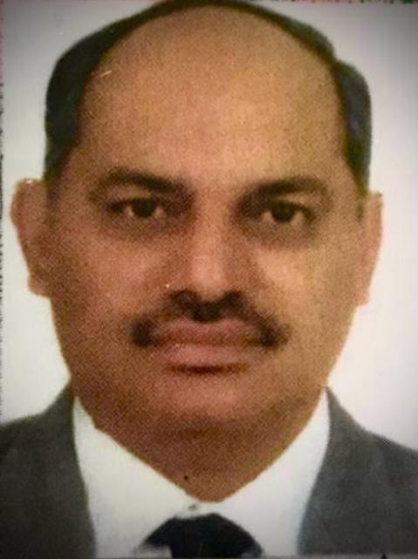

PROMOTERS
Veer Singh Malik
S.R. Baruah
Ankur Sangwan
Yadvendra Singh
Founder, Director
(International Logistics and warehousing expert, 22 years experience)
Email : vsmalik@icsprevail.com vsmalik@icsfreight.com M# 00-91-9811568390
North East , consultant.
IRS (Retd),Former Principal Chief Commissioner of Customs and Indirect Tax,C.B.I.C,Ministry of Finance,Govt of India
Email: srbaruah@hotmail.com , M# 00-91-9891083005
Director
( Custom Brokerage / Custom Clearance , 16 years experience)
Email: Ankur.sangwan@icsfreight.com, M# 00-91-9871362290
Director
(International Logistics and warehousing expert, 27 years experience)
Email: ysingh@icsprevail.com, M# 00-91-9818150581
CORPORATE:
ICS Group UNIT NO 317 A, 317 B, 317 C 3rd Floor, Satya the Hive, Dwarka Expressway, Sector 102, Gurgaon , Haryana 122505.

Slide 11
THANK YOU
ICS GROUP
www.icsfreight.com
www.icsprevail.com

